Slide 1

Grade Calculation Excel Automation
Project Supervisor: Dr. N.Sridevi, M.E., Ph.D.,
Name of the Student: M.VENKATARAKESH
Register Number: 38110293

Slide 2
Presentation Outline
Course Certificate
Introduction
Objectives
System Architecture / Ideation Map
Module Implementation
Application Snapshots
Results and Discussions
Conclusion & Future work
References

Slide 3
Introduction
Generally,in order to calculate grades we use manual formulas in Excel.We also need to enter the marks manually each time.
Our goal through this project is to automate this whole process with the help of RPA technology and Blueprism.
We can avoid doing the rote and recurring task of calculating grade for each student based on their marks repeatedly and save time with the help of this project

Slide 4
Objectives
At present,in order to calculate grades we have to use Excel Formulas.This makes the task repetetive and rote.We need to manually type the formulas for each student while calculating their grade.
In order to overcome the problem mentioned above,we will use RPA technology to automate the process of grade calculation.With the help of Digital Workers in Blueprism software our whole process of calculating the grades will be automated.It will save us a lot of time and make this task very efficient.

Slide 5
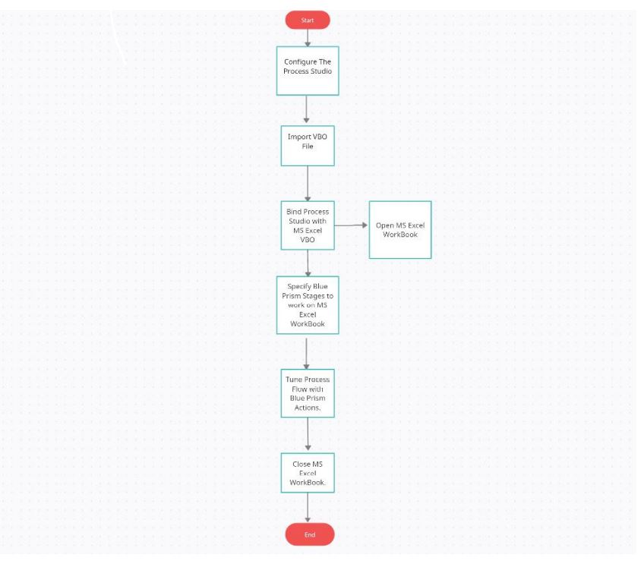
System Architecture / Ideation Map

Slide 6
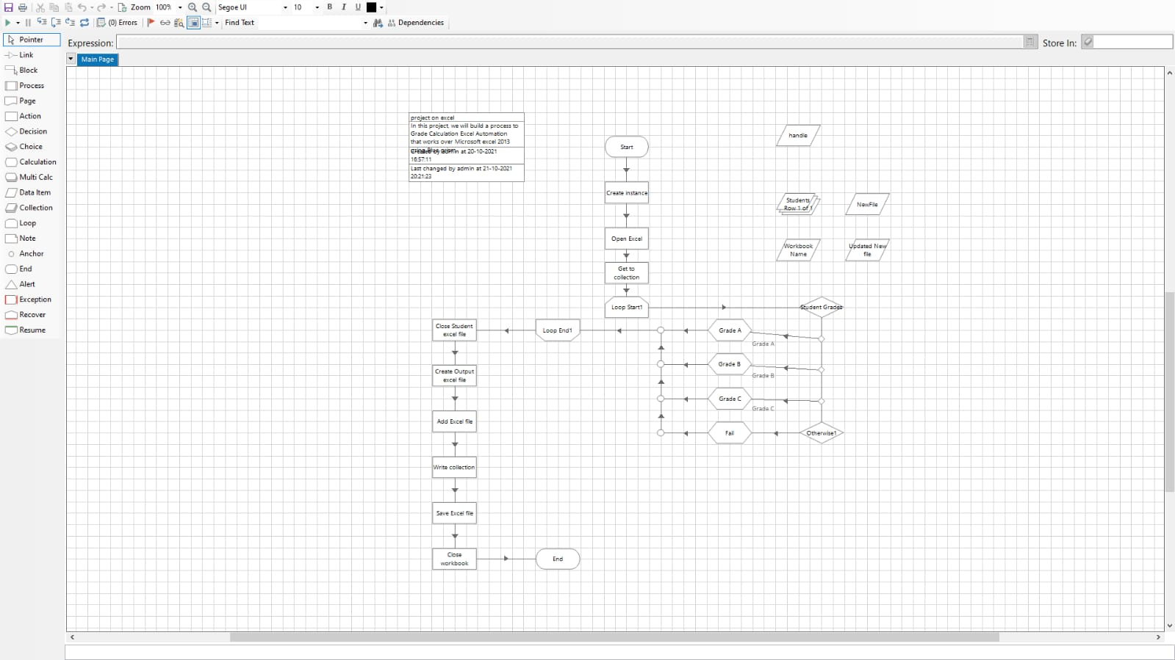
Project Implementation

Slide 7
Project Implementation
Hardware/Software requirements:
Windows 10 OS
Blueprism Software
Microsoft Excel
250 GB hard drive
Ram 8 GB
The technology we are using is known as Robotic Process Automation. Robotic process automation (RPA) is a software technology that makes it easy to build, deploy, and manage software robots that emulate humans actions interacting with digital systems and software.

Slide 8
Project Implementation
The software we are using is Blueprism.
The four main components of Blue Prism are:
Process Diagram-The entire process diagram has been attached above.
Process Studio-Here the process diagram is created.All the logics,control loops,stages and variables are executed here.
Object Studio- We import the Excel VBO here.
Application Modeller-We did not use this component in the project but it is mainly used to create an UI.

Slide 9
Project Implementation
Modules
Action stages:
Create instance
Open Excel
Get to collection
Close student Excel file
Create output Excel file
Add Excel file
Write collection
Close workbook

Slide 10
Project Implementation
Loop module:
Loop Start1
Loop End
Choice module:
Student Grades-
a.[Students.Percentage]>=70 AND [Students.Percentage]<=79
b. [Students.Percentage]>=80 AND [Students.Percentage]<=89
c. [Students.Percentage]>=90 AND [Students.Percentage]<=100
Otherwise1

Slide 11
Project Implementation
Calculation module:
Grade A
Grade B
Grade C
Fail

Slide 12
Methodology
Object-based approach
Object-based is the standard approach to automating all desktop applications. In this case, the bot emulates the actions of a real person, typing and clicking on buttons and other elements on the UI. It allows you to automate all actions in Excel that a real person can do, if they are routine and rule-based. However, when the bot interacts with the application UI rather than with the file directly, as when API is used the speed of execution is slower than with the two approaches above, and the application needs to be opened on the screen.
There are several approaches to automating Excel with RPA:
• Coding using RPA API and other API tools • Native actions for Excel automation • Object-based automation.

Slide 13
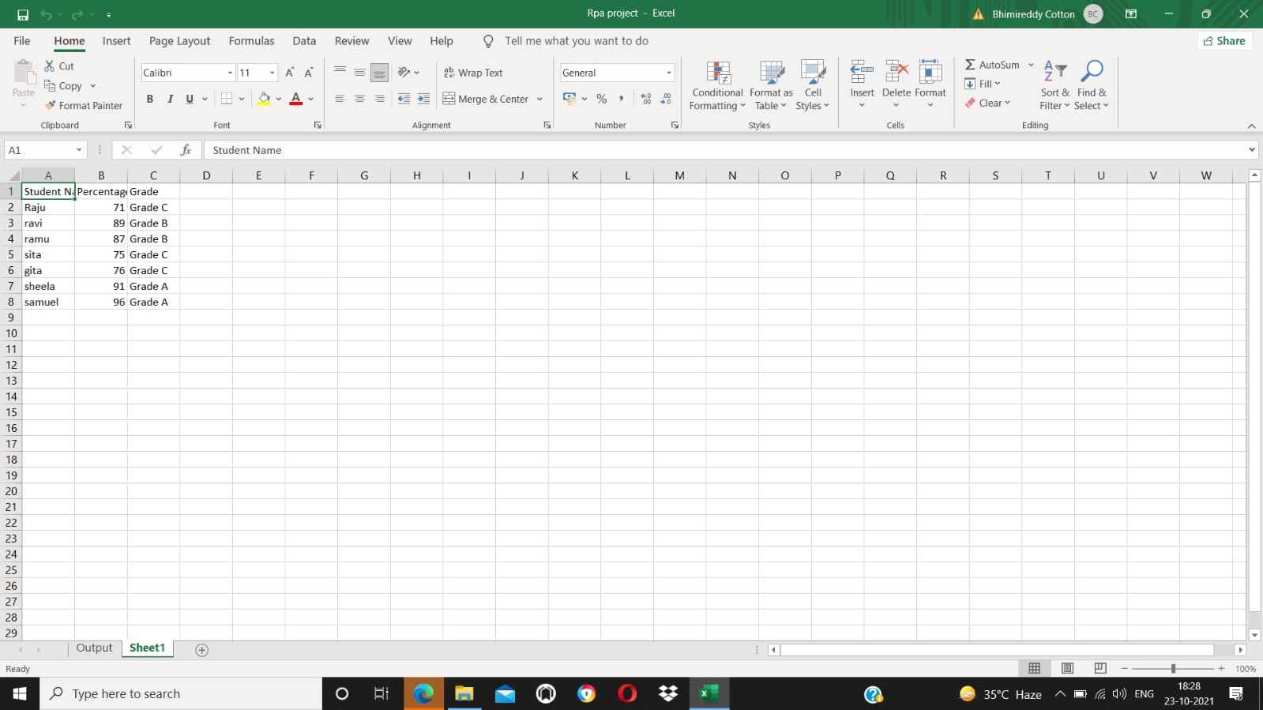
Results and Discussion
All the flows was executed successfully by reading the given Excel sheet and the output was stored new excel document as output.

Slide 14
Results and Discussion
As per the choice module used in the process studio,we have obtained the result and calculated the grades successfully.
All students who have secured a percentage between 70 to 79,they have got C Grade.
All students who have secured a percentage between 80 to 89,they have got B Grade.
All students who have secured a percentage between 90 to 100,they have got A Grade.

Slide 15
Conclusion
Thus, due to the various benefits of RPA, its utilization is gradually increasing in the market worldwide. Most of the organization are already implementing the RPA technology, as it optimizes the cost and press the others resources. It is a cost-effective technique and also has nonfinancial benefits such as it consists of more accurate and consistent processes, which are less prone to errors. Nowadays, most of the organizations are using RPA for testing the particular application and eliminating the old testing tools due to its limitations.

Slide 16
Conclusion
Our objective was to automate the process of grade calculation.
With the help of RPA and Blueprism tool we have successfully achieved our goal and also made the task of grade calculation very efficient.
This solution can be applied in schools or colleges which have a rich IT infrastructure so that people can be more efficient and use their saved time in other areas of work.
It can also be applied by private tutors so that the menial job of repetitive calculation of grades for each student can be avoided as the whole process gets automated.

Slide 17
Conclusion
Future Scope
The technology is advancing rapidly in almost all the fields, not in a minute but in every second. With this quick development in technology, tremendous growth has been observed in the global automation industry. The usage of automation techniques is in continuous growth and it is anticipated for the predictable future. The robotic process automation is one of the revolutions in the automation industry, and its expected to increase higher potential terms of utilization and staff implementation in the upcoming year.

Slide 18
References
Websites:
https://ieeexplore.ieee.org/Xplore
www.uipath.com
Research paper:
Robotic Process Automation: A Scientific and Industrial Systematic Mapping Study By J. G. Enríquez;A. Jiménez-Ramírez;F. J. Domínguez-Mayo;J. A. García-García

